Slide 1
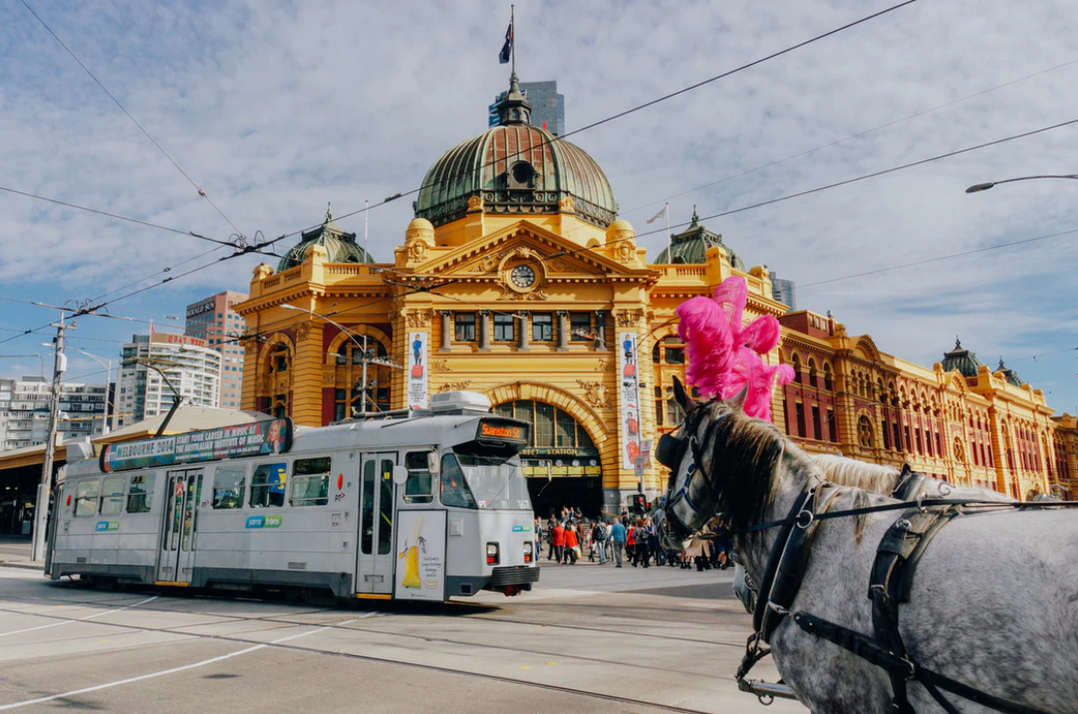
Italian Restaurant Location
Coursera Capstone Project by Matt Burt
Analysis of Melbourne Suburb Restaurant and Price Data

Slide 2
Introduction/Business Problem
I am thinking of opening an Italian restaurant in Melbourne but am unsure where to open it.
My problem is finding a suburb without a lot of existing Italian restaurants but also one that is not too expensive.
I will need to use Foursquare data to analyse how many restaurants are in each suburb and property sales data to determine the most affordable suburbs.
I am planning on converting a residential house for my restaurant.

Slide 3
Data Requirements
A list of suburbs within Melboure.
Restaurant types present within a certain radius by suburb.
Sales data by suburb.
Sources:
Wikipedia: https://en.wikipedia.org/wiki/List_of_Melbourne_suburbs
Foursquare data
Melboure Sales Data - Open Data Victoria

Slide 4
Methodology
Step 1: Gather all of the required data.
I used Pandas to scrape data from wikipedia and also to query Foursquare.
I used geocode to convert the address of each suburb into coordinates.
I downloaded sales price data and manipulated it in Microsoft Excel before manipulating it further in Pandas.
Step 2: Cleaning and Exploring the data.
I used Folium and Pandas to explore the initial data.
I used Pandas to clean, group and merge the relevant data sources into one data frame.

Slide 5
Step 3: K Means Clustering
I used Sci-Kit Learns K Means Clustering algorithm to create 5 clusters and assign each suburb to one of these clusters based on Resturants present and average house sales price.
Step 4: Visualising Results
I used Folium to geographiclaly visualise the clusters.
I used Pandas to visualise the clusters in a tabular format.
Step 5: Conclusions
I used the Folium map and also the tabular data to decide the most appropriate location for my Italian Restaurant. I made my decision based on price and number of Italian Restaurants present in each suburb.

Slide 6
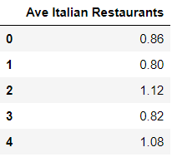
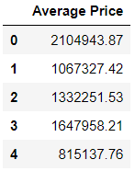
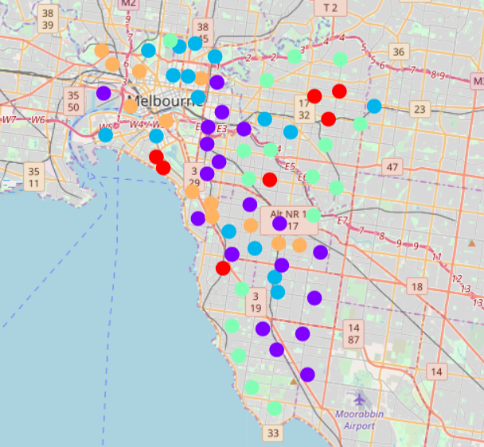
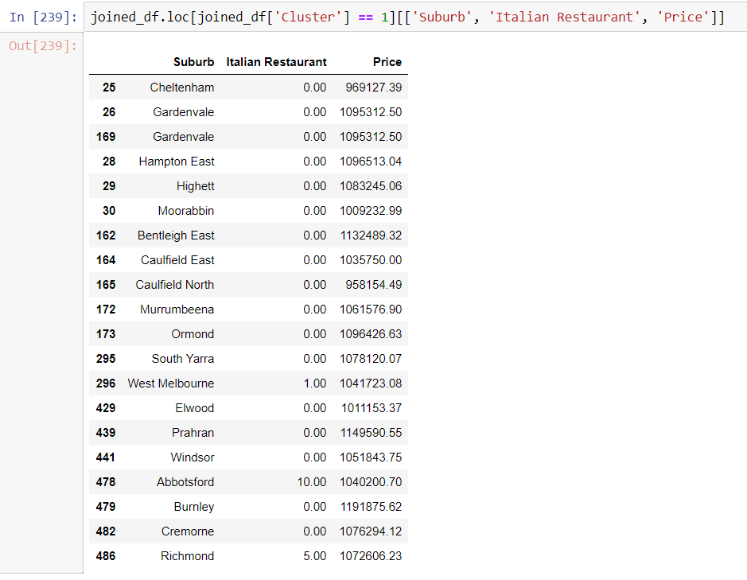
Results

Slide 7
Results
Cluster 0: Average Italian Resturants for each suburb in this cluster is 0.86 and average price is $2,104,943.87.
Cluster 1: Average Italian Resturants for each suburb in this cluster is 0.80 and average price is $1,067,327.42.
Cluster 2: Average Italian Resturants for each suburb in this cluster is 1.12 and average price is $1,332,251.53.
Cluster 3: Average Italian Resturants for each suburb in this cluster is 0.82 and average price is $1,647,958.21.
Cluster 4: Average Italian Resturants for each suburb in this cluster is 1.08 and average price is $815,137.76.

Slide 8
Discussion
Cluster 1 has the lowest average number of Italian Restaurants per suburb and is the second cheapest cluster by historic sales price.
Cluster 4 is the cheapest by historic sales price but has a relatively high average number of Italian Restaurants at 1.08.
Cluster 0 is the most expensive cluster with an average suburb sales price of $2,104,943.87.
Cluster 3 has a relatively low number of restaurants in general and a high average sales price of $1,647,958.21.

Slide 9
Conclusion
Cluster 1 is the most appropriate cluster to choose the final suburb for my Italian restaurant from. This is due to the low nu mber o fexisting Italian Restaurants in this cluster and its relatively low sales price.
In cluster 1, the suburb with the most Italian restaurants is Abbotsford, with 14. The two suburbs that are adjacent to Abbotsford are Richmond and Burnley. Richmond has 5 Italian Restaurants and Burnley has none.
Burnley is the most appropriate suburb for my new Italian restaurant.

Slide 10
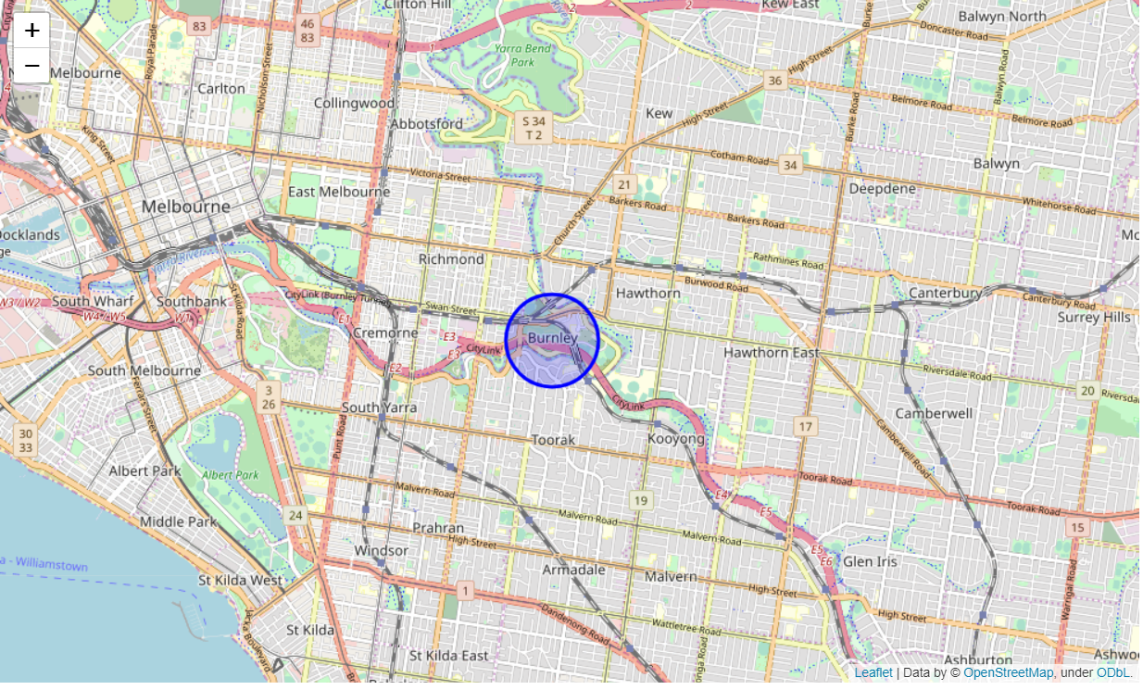
Conclusion

